Slide 1
Probabilistic Latent Variable Models for Knowledge Discovery and Optimization
Xiaolong Wang
Department of Computer Science
Apr-3-2016
Doctoral Committee:
Prof. Chengxiang Zhai, Chair
Prof. Jiawei Han
Prof. David Forsyth
Prof. Joy Ying Zhang, CMU & Facebook
Prof. Angelia Nedich, UIUC & ASU

Slide 2
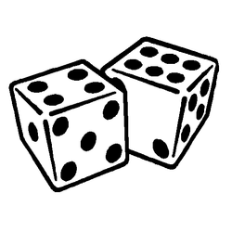
We must become more comfortable with probability and uncertainty
⎻ Nate Silver
Notes:
Nate Silver is a statistician who analyzes baseball and elections.
Forecast player performance based on measurements such as batting average for hitters or strikeout rate for pichers
Regression
Clustering players
Silver successfully called the outcomes in 49 of the 50 states in the 2008 U.S. Presidential election
In the 2012 United States presidential election, Silver correctly predicted the winner of all 50 states and the District of Columbia
Classification

Slide 3

An Era of Abundant Data
How To:
Represent the data and knowledge?
Model uncertainty and noise?
Scale well to large data?
Network
Text
Probabilistic Modeling
with Latent Variables
Images
Notes:
With increasing amount of the different types of data, how to we extract useful information?
In social network, who are spammers? How to find communities and how to characterize?
In news, how to find emerging topics? In literature, how to generate short summary for research evolution
Image recognition and segemantation

Slide 4
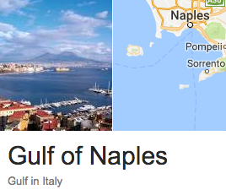
PLVM – An Historical Account
L
1893
W
R = W / L
Ratio of forehead width to the body length of 1000 crabs
Raphael Weldon
1860 - 1906
Notes:
Weldon collected 1000 crabs in Naples Bay in 1893 and
Measured the ratio of forehead width to the body length.
He plotted the histogram and fitted with a normal distribution.
However, he has his own doubts: there is a
“A well-marked deviation from this normal shape”
And he thinks
“the units grouped together in the measured material are
Not really homogeneous”
In other words, he hypothesized that the crabs are possibly
coming from two subspecies
With limited math knowledge, he turned to Pearson for help

Slide 5
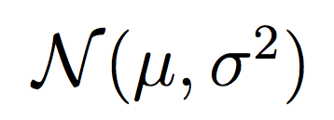
PLVM – An Historical Account
L
1893
W
R = W / L
Ratio of forehead width to the body length of 1000 crabs
Raphael Weldon
1860 - 1906
Karl Pearson
1857 - 1936
“A well-marked deviation from this normal shape”
A single normal fitting with
Maximum Likelihood Estimation (MLE)
“the units grouped together in the measured material are not really homogeneous??”
Notes:
Weldon collected 1000 crabs in Naples Bay in 1893 and
Measured the ratio of forehead width to the body length.
He plotted the histogram and fitted with a normal distribution.
However, he has his own doubts: there is a
“A well-marked deviation from this normal shape”
And he thinks
“the units grouped together in the measured material are
Not really homogeneous”
In other words, he hypothesized that the crabs are possibly
coming from two subspecies
With limited math knowledge, he turned to Pearson for help

Slide 6
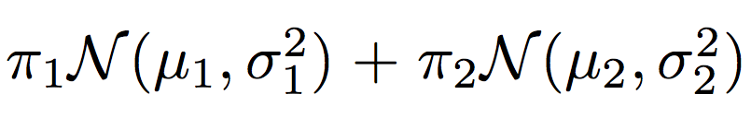
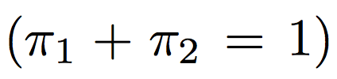
PLVM – An Historical Account
Karl Pearson
1857 - 1936
Model of 5 free variables
Matching on first 5 moments
Solving a 9th-degree polynomial
Two-normal fitting with Moment Matching (MOM)
Notes:
Pearson used two normal distributions to fit the data.
Nowadays we can use EM algorithm to compute the MLE.
At Pearson’s time computer was not invented yet so he chose to
Use moment matching (he also invented mom!).
Here we have 5 free variables, and thus we need to do moment
Matching up to the 5th moments.
Still this was a tedious computation task which amounts to a 9th
Degree poly
We plot the two curves of the component and their mixture is also
Shown which indeed seems a better fitting than walden’s result

Slide 7
PLVM – An Historical Account
Raphael Weldon
1860 - 1906
Karl Pearson
1857 - 1936

Slide 8
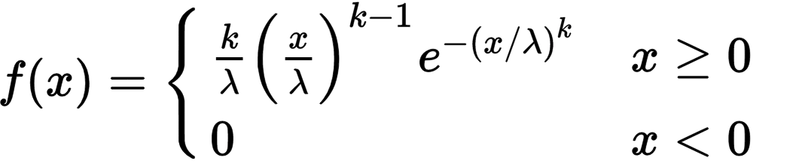
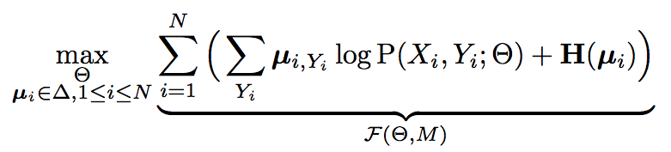
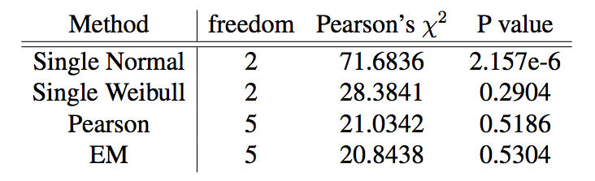
PLVM – An Historical Account
Modern alternatives:
Weibull Distribution
Two-normal with EM
Fréchet (1927)
Notes:
The advantage of PLVM is that we can use simple distributions to model complicated latent phenomenials.
For example, if we choose to use a single distribution to fit the crab data, probably the best choice is
Weibull distribution proposed in 1927. However, its computation is not possible without numeric means.
And it does not show the useful knowledge about the two subspecies.
Nowadays, we can use EM algorithm which is more popular. It’s computation is simple, but requires computer
Because it can take more than hundreds of iterations.

Slide 9
PLVM – An Historical Account
Modern alternatives:
Weibull Distribution
Two-normal with EM
Fréchet (1927)
Complicated Density Function
Hard to Do MLE Fitting
Notes:
The advantage of PLVM is that we can use simple distributions to model complicated latent phenomenials.
For example, if we choose to use a single distribution to fit the crab data, probably the best choice is
Weibull distribution proposed in 1927. However, its computation is not possible without numeric means.
And it does not show the useful knowledge about the two subspecies.
Nowadays, we can use EM algorithm which is more popular. It’s computation is simple, but requires computer
Because it can take more than hundreds of iterations.

Slide 10
PLVM – An Historical Account
Modern alternatives:
Weibull Distribution
Two-normal with EM
Why PLVM?
Flexible Modelling
Powerful Tool for KDD
Efficient Optimization
Fréchet (1927)
Complicated Density Function
Hard to Do MLE Fitting
Approximating MLE
Efficient Optimization
Notes:
The advantage of PLVM is that we can use simple distributions to model complicated latent phenomenials.
For example, if we choose to use a single distribution to fit the crab data, probably the best choice is
Weibull distribution proposed in 1927. However, its computation is not possible without numeric means.
And it does not show the useful knowledge about the two subspecies.
Nowadays, we can use EM algorithm which is more popular. It’s computation is simple, but requires computer
Because it can take more than hundreds of iterations.

Slide 11
Citation LDA: Understanding Evolution of Research Themes
Dual Clustering Maximum Entropy
PLANS: Phrasal Latent Allocation with Negative Sampling
Thurstonian Pairwise Preference

Slide 12
The Evolution Graph
Discovering the Research Topics
Topic Milestone Papers
What paper represents the topic?
Topic Temporal Strength
When does the topic emerge/fade?
Topic Keywords
How to summarize the topic?
Discovering the Theme Evolution
Topic Importance
Which topic is more important?
Topic Dependency
Which topic enables other topics?
Evolution Patterns
Do topics merge? or get branched?
Notes:
Given a corpus literature citations, we are intersted in

Slide 13
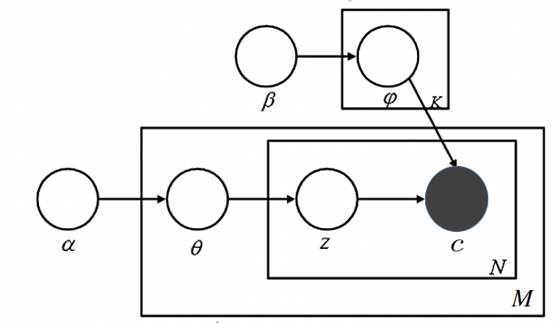
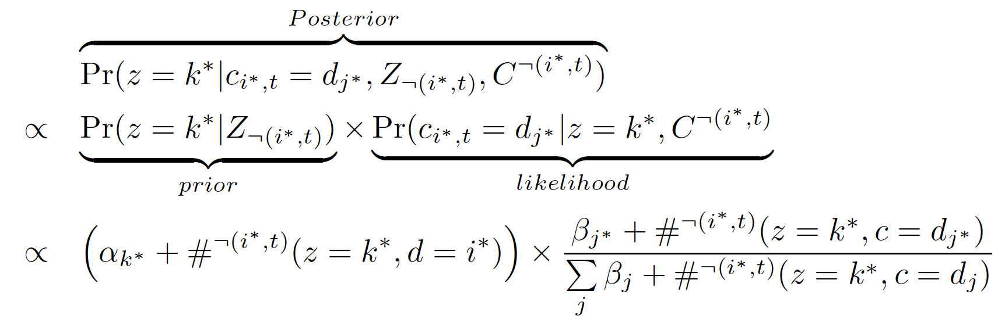
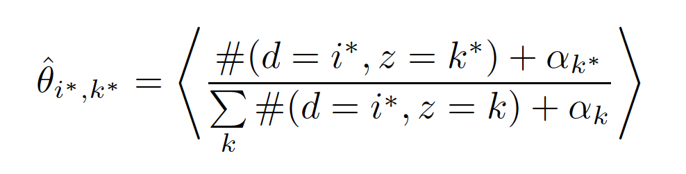
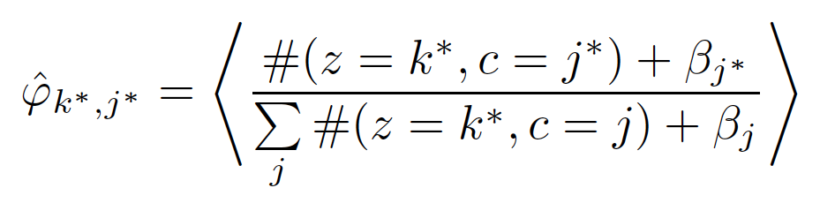
Citation-LDA
Multinomial over Cited Papers Given a Topic
 | LDA | Citation-LDA
Topic | Distribution over Words | Distribution over Cited Papers
Document | Bag of Words | Bag of Cited Papers
Gibbs Sampling of z:
Multinomial over Latent Topics Given a Citing Paper
Posterior Expectation:
Same as LDA
Notes:
The generative model is no different from the LDA model.
However, each topic is a distribution over cited papers
and each document is represented as a bag of cited papers.

Slide 14
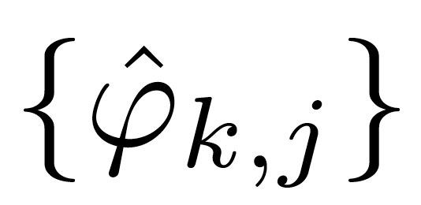
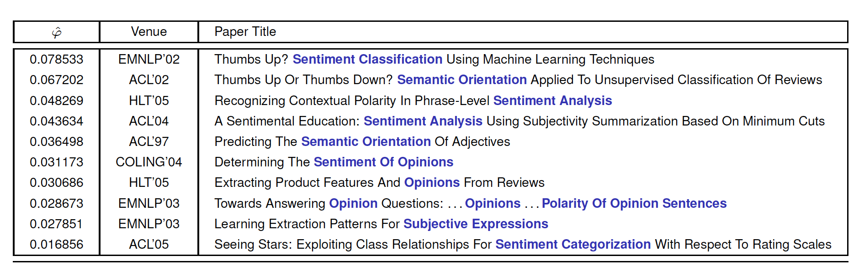
Discovery of Research Topics
1. Topic Milestone Papers
Rank papers by , probability of citing paper j in topic k
ACL Anthology Network (AAN), Topic 89 of 100 Topics
Notes:
It means 7 percent of sentiment analysis papers cite Pang Bo's paper

Slide 15
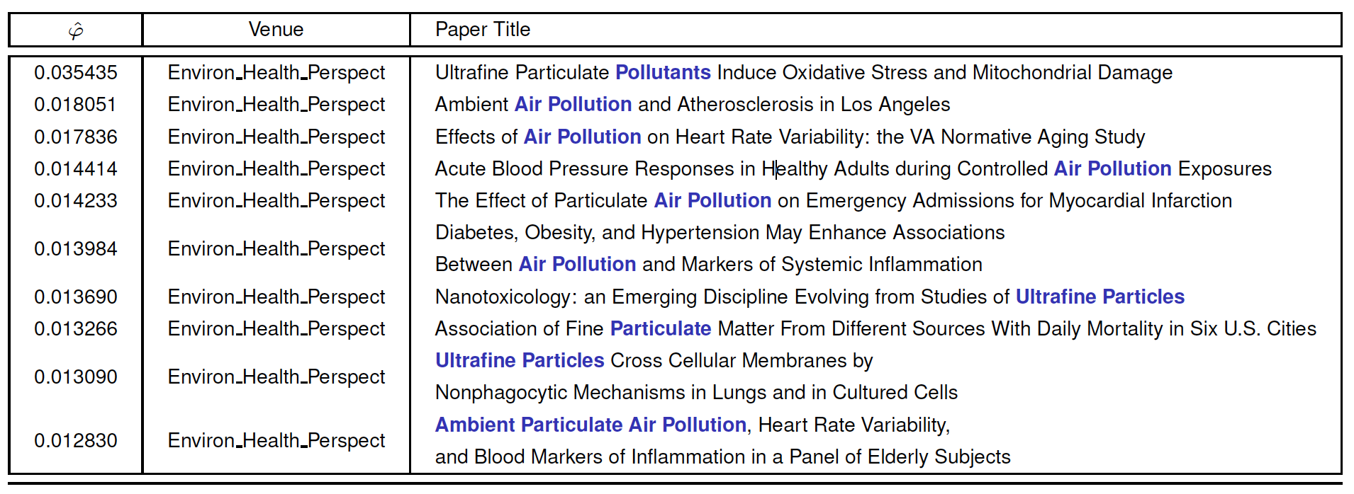
Discovery of Research Topics
1. Topic Milestone Papers
Rank papers by , probability of citing paper j in topic k
PubMed, Topic 175 of 500 Topics
Notes:
Air pollution

Slide 16
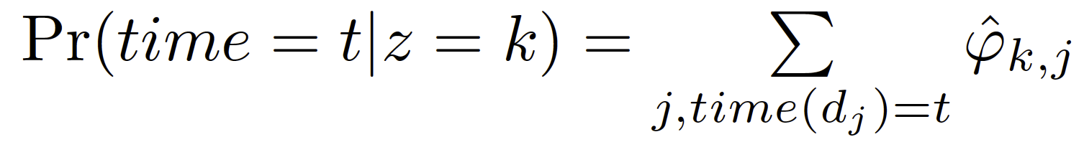
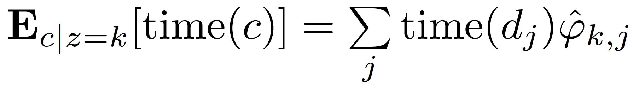
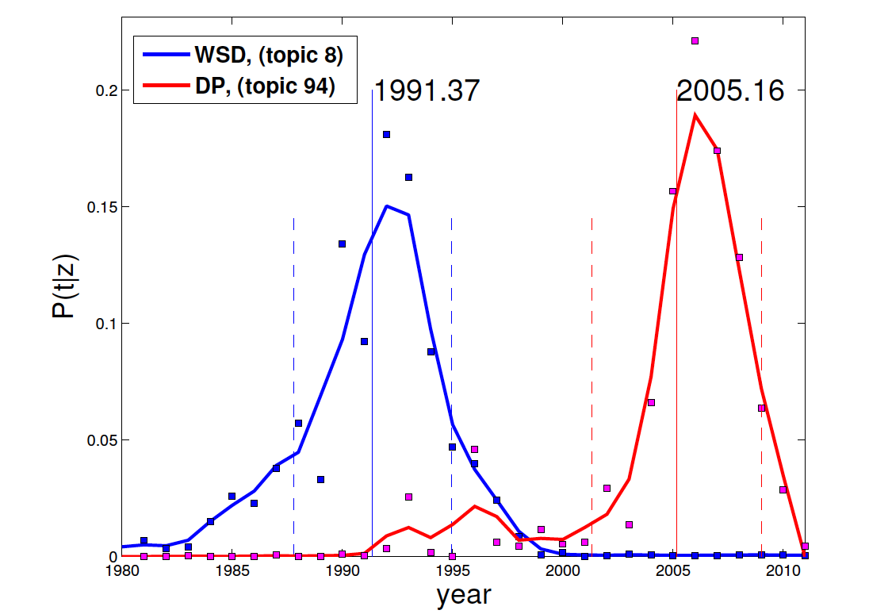
Discovery of Research Topics
2. Topic Temporal Strength
Temporal distribution
Topic expectation time
Word Sense Disambiguation (WSD) 8th topic in AAN
Dependency Parsing (DP) 94th topic in AAN
Notes:
The expectation time can be regarded as the peaked time when the topic was most researched

Slide 17
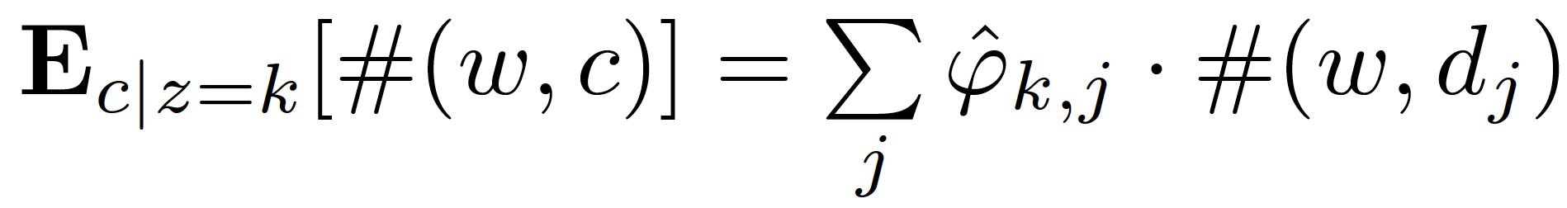
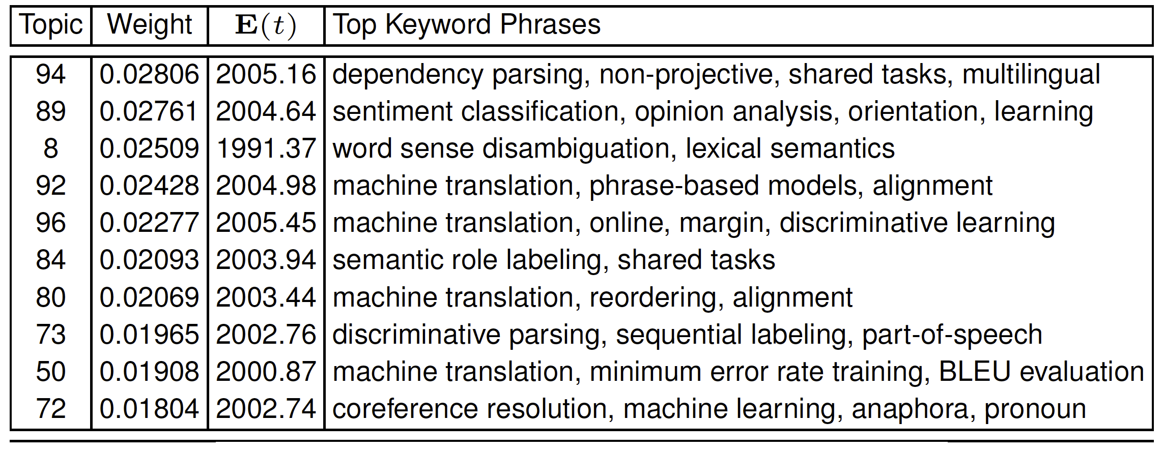
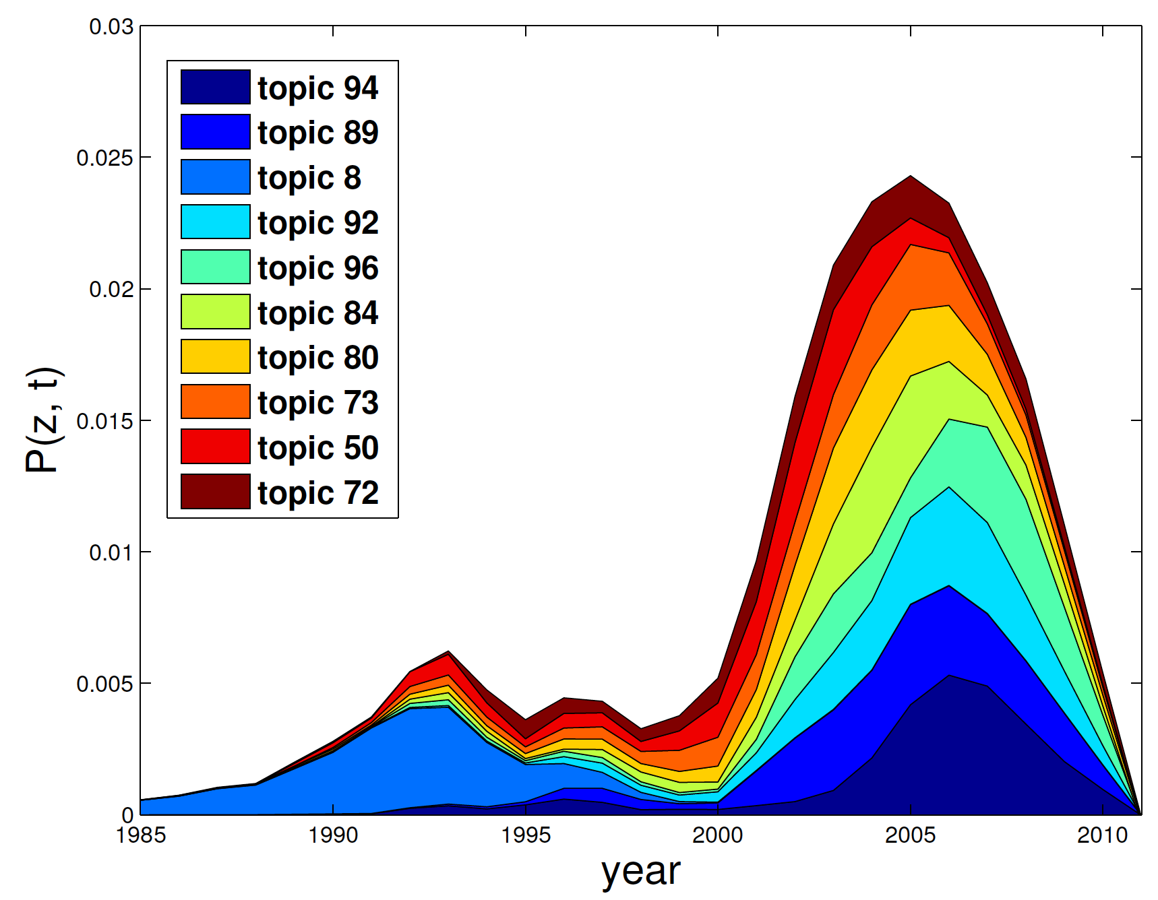
Discovery of Research Topics
3. Topic Keywords
Extract words of title (or abstract)
Top 10 Topics in AAN
Notes:
Those are 10 most dominant topics in AAN, such as dependency parsing, sentiment analysis, WSD. Especially, we find
Machine translation a big research theme composed of multiple research topics such as

Slide 18
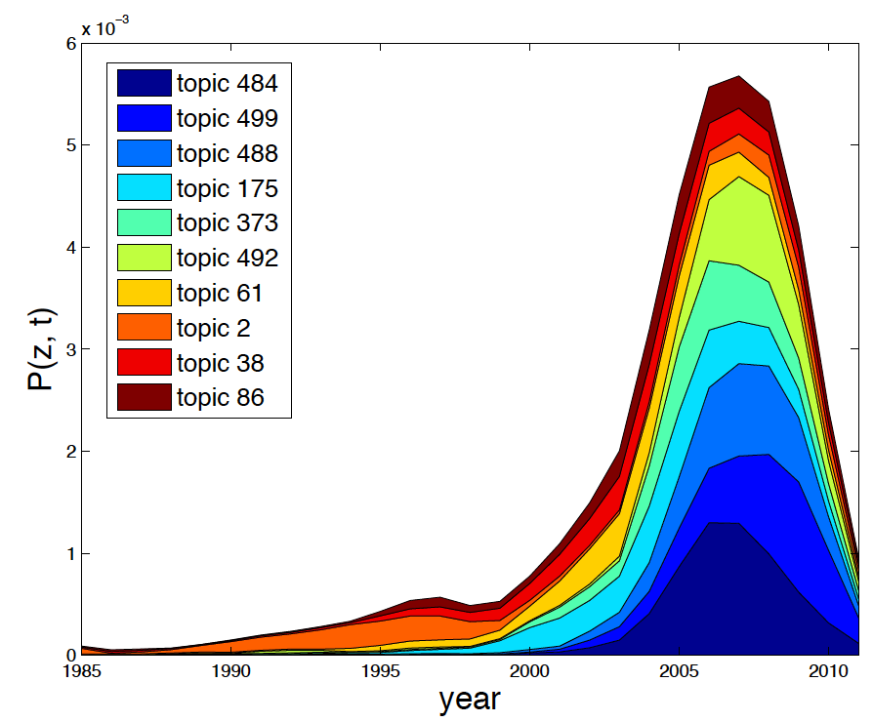
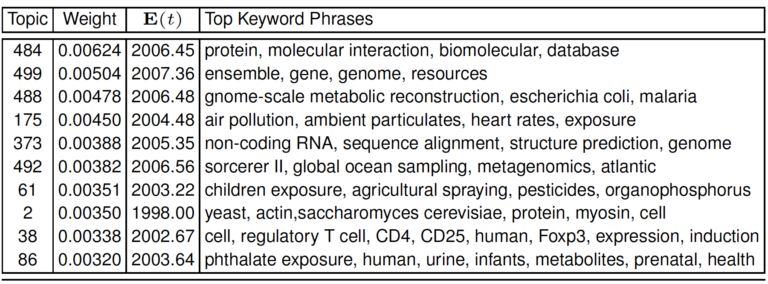
Discovery of Research Topics
3. Topic Keywords
Extract words of title (or abstract)
Top 10 Topics in PubMed

Slide 19
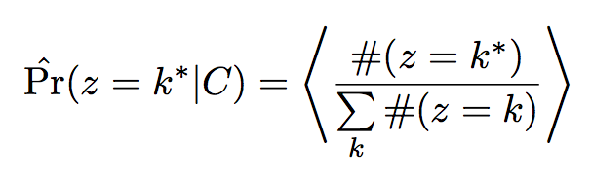
Discovering the Theme Evolution
4. Topic Importance
Rank topic by
Notes:
Topic importance is computed as the empirical distribution of
Samples from a topic
Dependency is mathematically represented as the probability of
Given a topic, what’s the probability of citing another topic.
And to compute, we just need to marginalize through all the possible papers
It also can be leveraged to compute the evolution patterns where each edge
Is computed as the denpendency

Slide 20
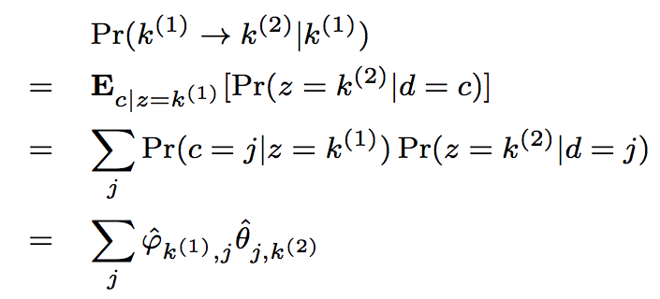
Discovering the Theme Evolution
5. Topic Dependency
Topic k⁽¹⁾ citing Topic k⁽²⁾
6. Evolution Patterns
Plot the graph of dependencies between topics
Chance of paper j citing topic k⁽²⁾
d₁
d₂
d₃
k⁽¹⁾
k⁽²⁾
Importance of paper j in topic k⁽¹⁾
Topic Dependency
Notes:
Topic importance is computed as the empirical distribution of
Samples from a topic
Dependency is mathematically represented as the probability of
Given a topic, what’s the probability of citing another topic.
And to compute, we just need to marginalize through all the possible papers
It also can be leveraged to compute the evolution patterns where each edge
Is computed as the denpendency

Slide 21
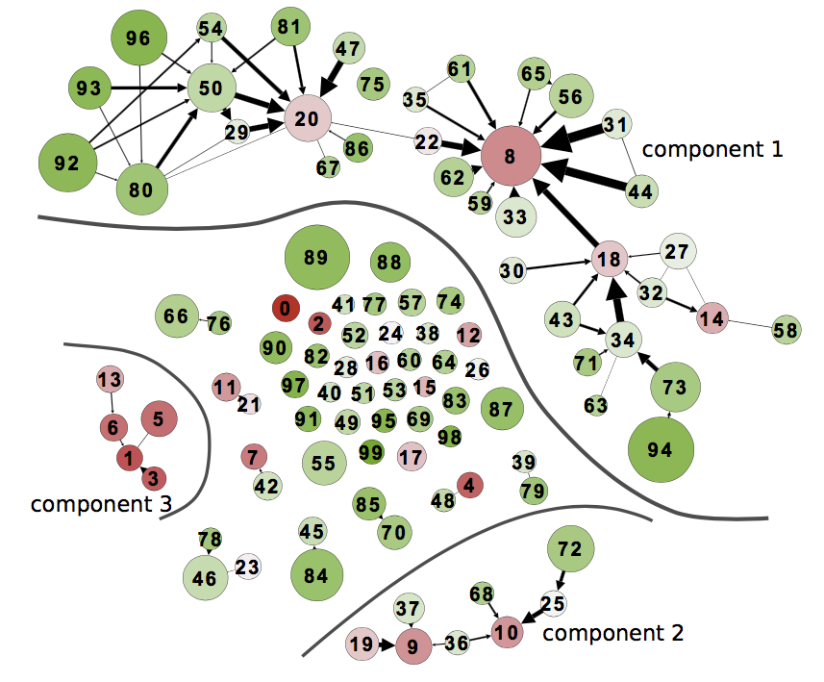

Discovering the Theme Evolution
Word Sense Disambiguation, 91’
1983’
2013’
Statistical Machine Translation
Prepositional Phrase Attachment, 94’
Statistical Parsing, 99’
Grammars
(faded in 90s)
Discriminative Parsing, 03’
Dependency Parsing, 05’
Discourse/Dialogue
Summarization
AAN
Notes:
Thickness of edge represents the dependency from one topic to another topic.
We only plot a edge if the dependency is significant. And it can be used to show
Research theme evolution

Slide 22
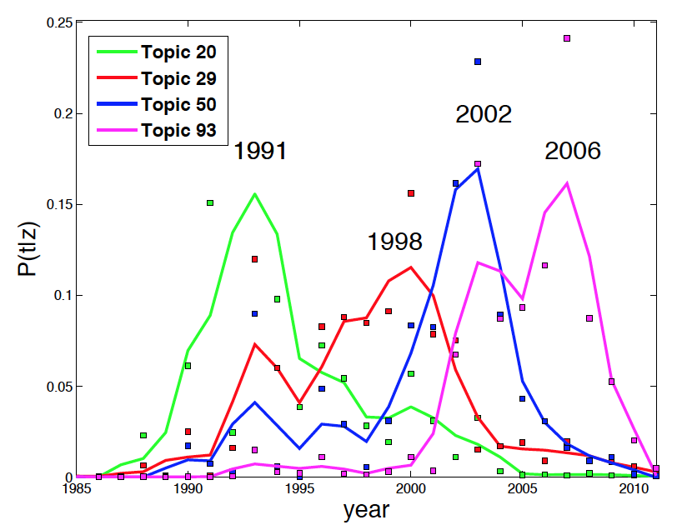
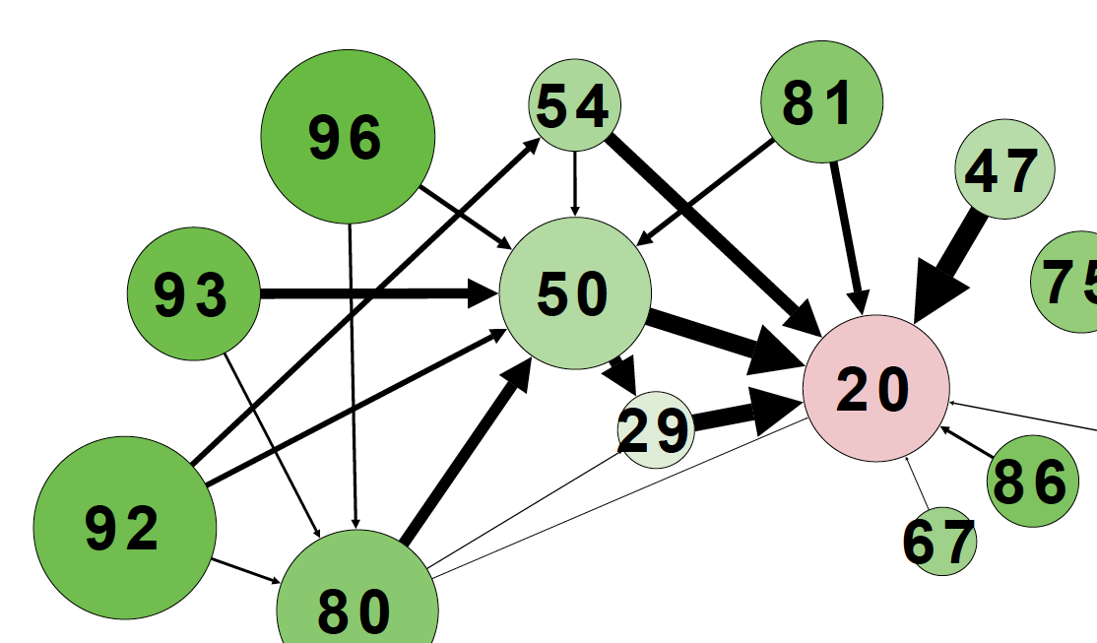
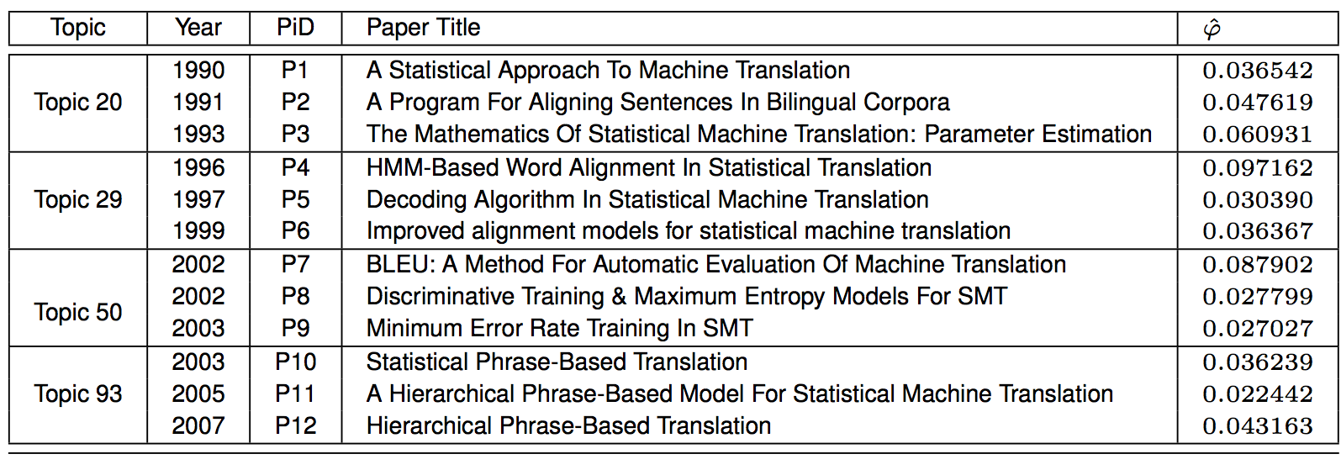
Discovering the Theme Evolution
Statistical Machine Translation
1983’
2013’

Slide 23
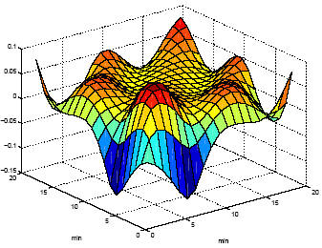

Citation-LDA: Summary
Flexible Modelling
Modeling Citations as a Mixture of Latent Topics
Discovering Research Topics:
milestone papers, temporal strength, keywords
Discovery the Theme Evolution:
topic importance and dependency, theme evolution patterns
Citation-LDA: a General Modelling Method for Network Data
Powerful Tool for KDD

Slide 24
Citation LDA: Understanding Evolution of Research Themes
Dual Clustering Maximum Entropy
PLANS: Phrasal Latent Allocation with Negative Sampling
Thurstonian Pairwise Preference

Slide 25


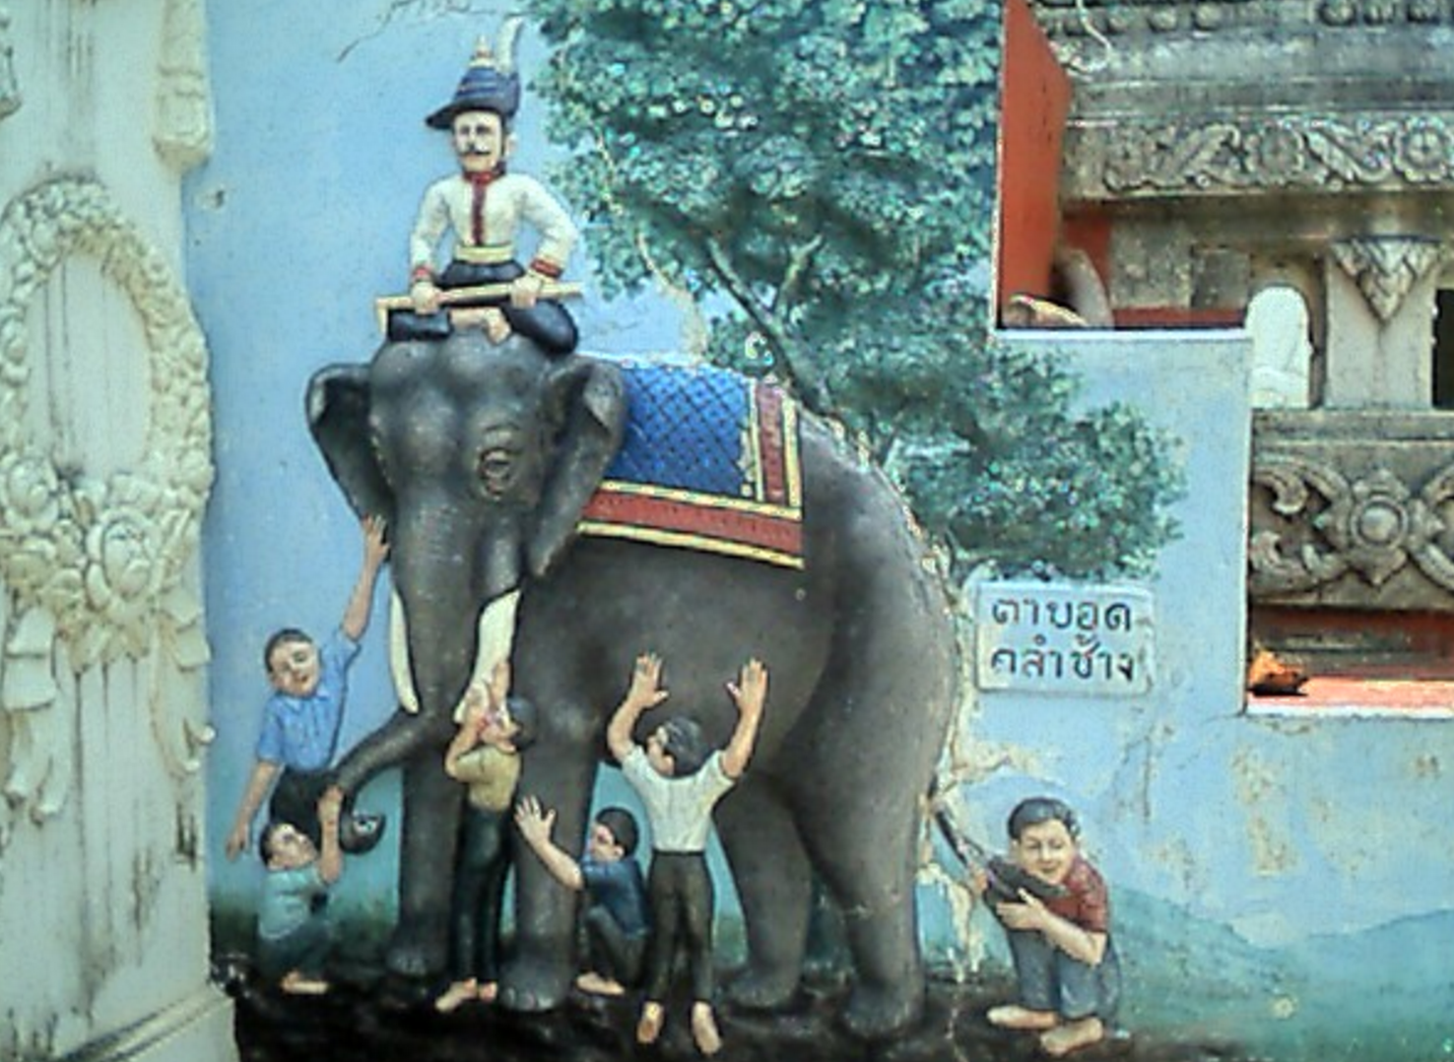





Blind Men and The Elephant: Convert Ranking to Pairwise Preferences
a Complicated Problem
a Series of Smaller and Easier Tasks
Ranking
annotated by
Experts
Pairwise Preferences
annotated by
Crowd Workers
TPP
Thustonian Pairwise Preference (TPP)
Query Difficulty and Domain
Worker Expertise and Truthfulness
Challenges:
Incompleteness and Inconsistency
Notes:
Suppose we have a complicated problem, it is natural to break down the problem into
a series of smaller and easier tasks.
Just like blind men and the elephant, though the ability of each blind men is limited,
They can each touch a part of the elephant such as tusks or the leg.
However, if there is no an intelligent thinking machine to synthesis the
observations, they would disagree, and argue and there is no conclusion achieved.
The major challenges is to resolve incompleteness and inconsistency.
We investigate this idea in the crowdsourcing setting. Insetad of annotating
Ranked list by experts, we ask crowd workers to label only pairwise preferences.
Our challenges is because of the non-expert nature of the workers, we need to estimate
Query difficulty, domain, worker expertise and truthfulness.

Slide 26
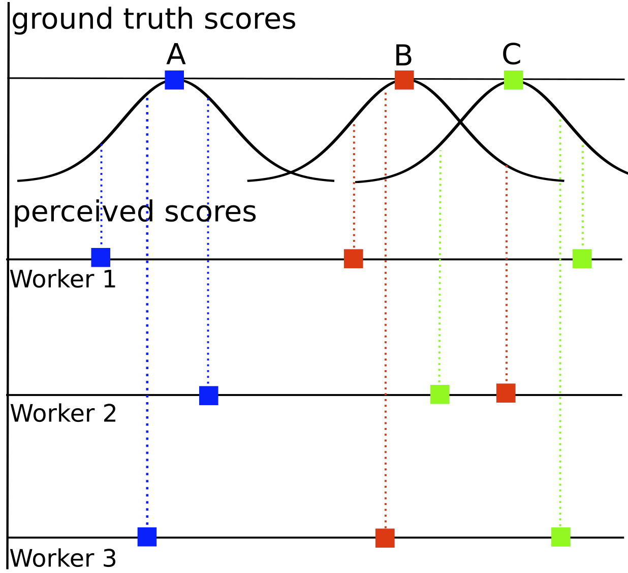
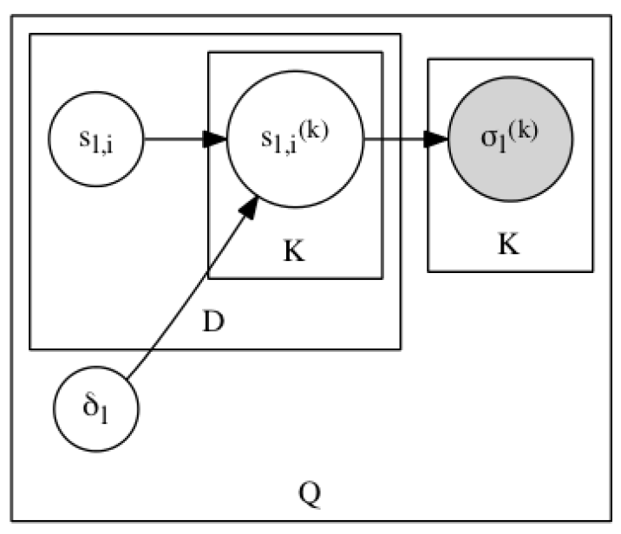
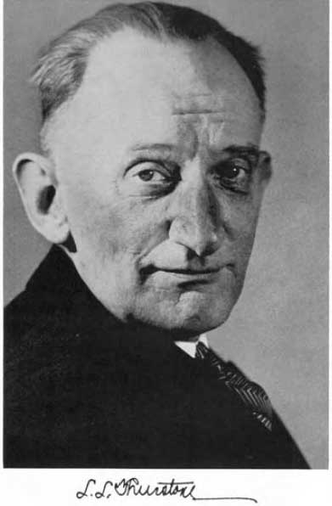



Thurstonian Ranking Model (TRM): PLVM for Ranked Lists
ground truth score (mean)
perceived score
Worker
A > B > C
Doc
Louis Leon Thurstone
1887 - 1955
difficulty (std)
Observation:
ranking
A > C > B
Query
A > B > C
First scalable algorithm
Gibbs sampling
By Ulf Böckenholt (92’-93’), (was) a UIUC Professor
Which one or what is the true ranking?
TRM is a PLVM modelling ranked lists as judgements following normal distributions
Ulf Böckenholt
Notes:
Let us first take a moment to consider a simpler problem where our observation is the ranked
lists annotated by workers, and the goal is to estimate the ground truth ranked lists. Thurstonian
Proposed the TRM.
He assumed that the judgements of the ranked lists is a result of the real-value perceived scores
From each worker and the worker’s perceived score is distributed as normal with means called
Ground truth scores.
The first practical algorithm for optimization was proposed by bockenholt. He was a uiuc professor
When the work was done. Estimation was done using gibbs sampling

Slide 27
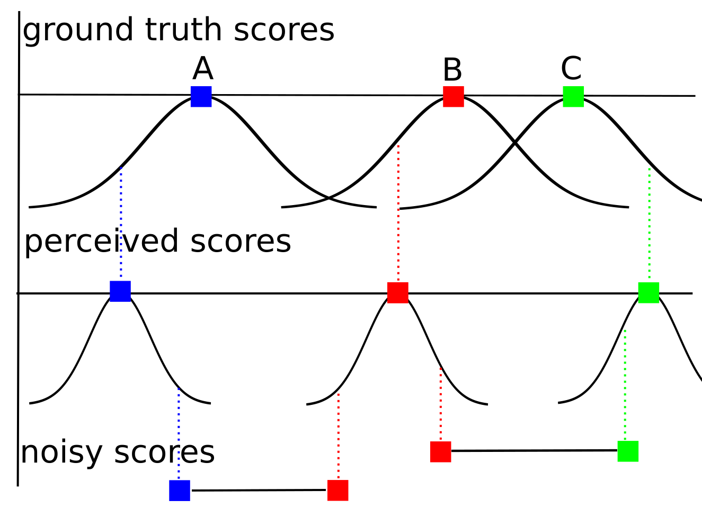
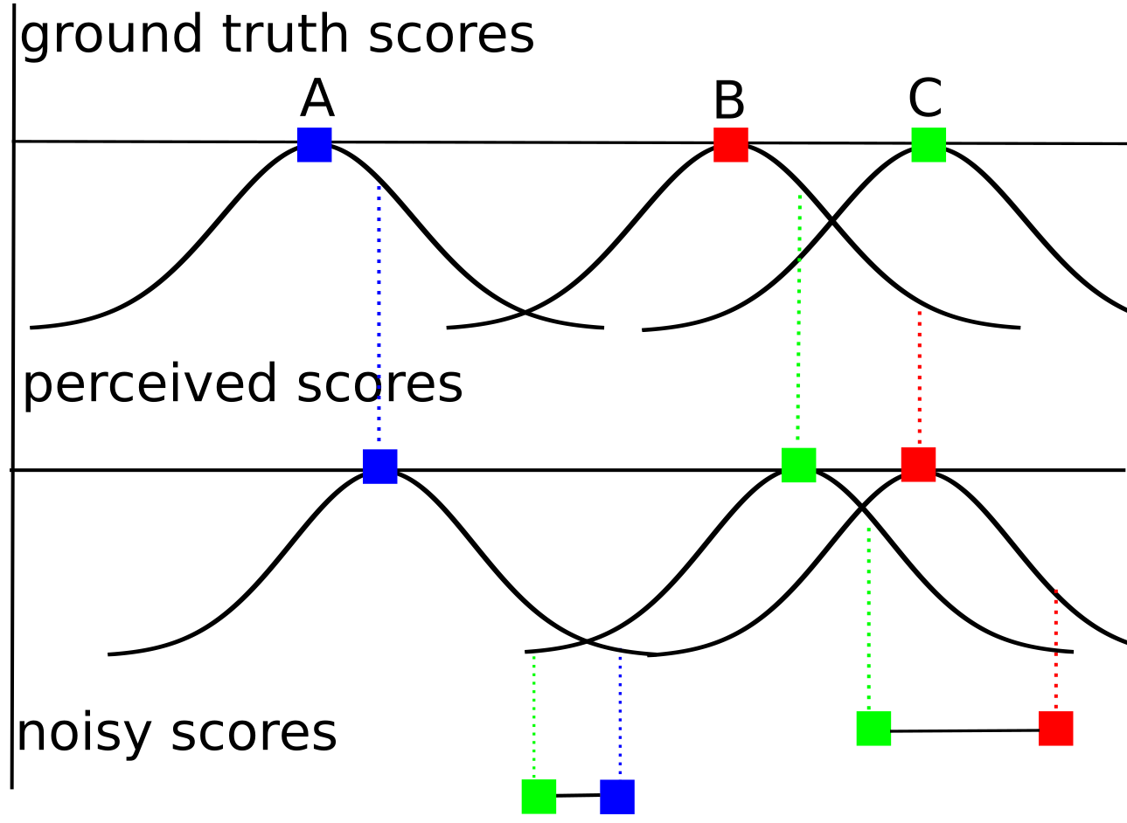
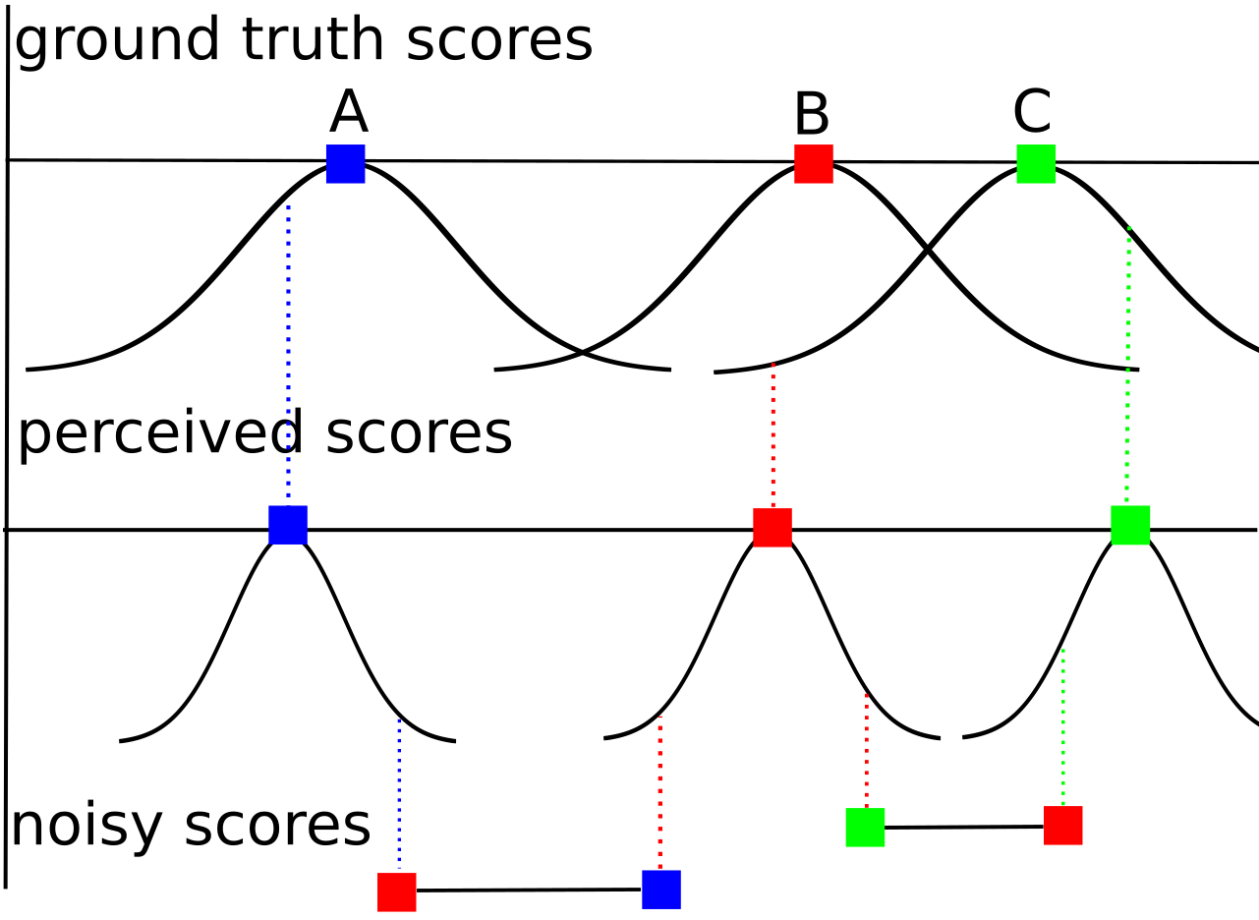

Thurstonian Pairwise Preference (TPP): PLVM for Pairwise judgements
Worker
Expertise
Modelling Pairwise Preferences:
Query
Difficult
No Error
Error due to Low Expertise
Error due to “Flipping”
Expert (on the query domain)
Truthful
Limited expertise
Truthful
Expert
Malicious
Error due to Difficult Query
Notes:
After generating the perceived score, in our setting we need to further generate the pairwise preferences.
We assume in addition to TRM, there is another step of generation, which draws noisy score from normal
distributions with mean being the perceived scores. The variance of this normal distribution is determined by
The domain expertise of the workers as well as their truthfulness.
Here are some examples.

Slide 28
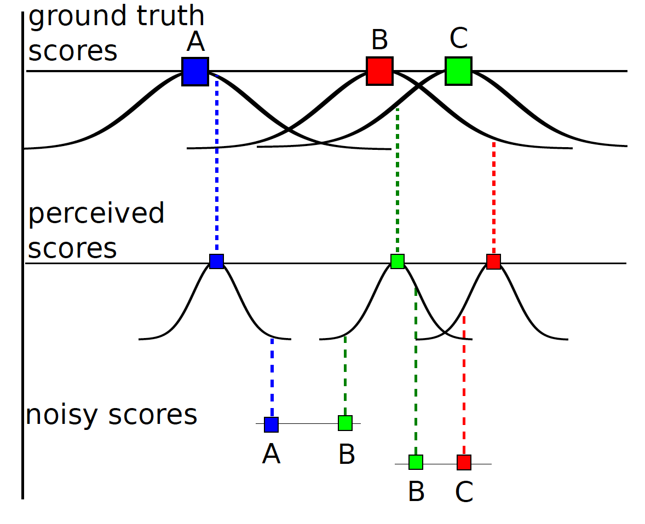
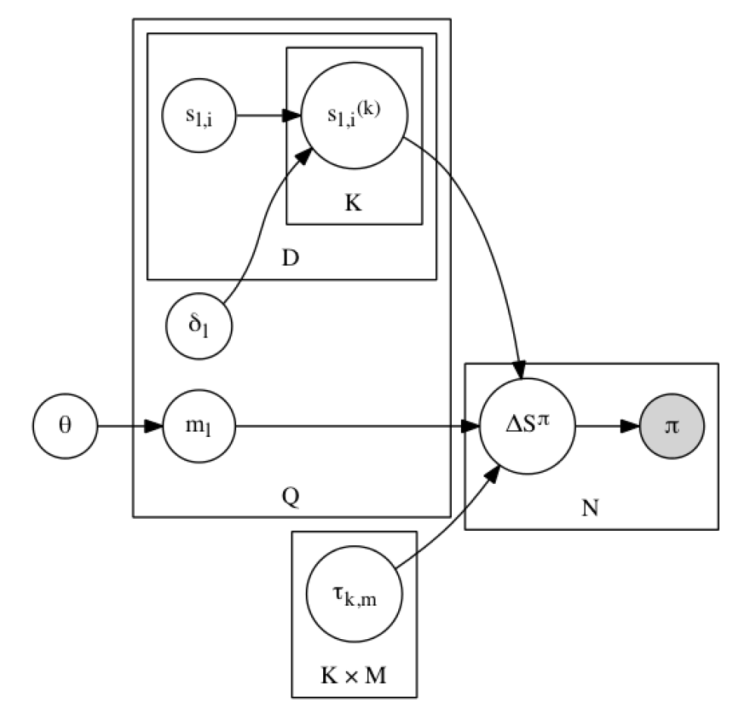
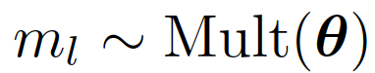
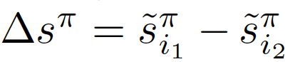
Thurstonian Pairwise Preference
ground truth score (mean)
perceived score
(mean)
Worker
Doc
noisy score difference
query domain
mixture prior
difficulty (std)
TRM
domain
Judgement
query domain:
Query
expertise and
truthfulness (std)
Observation:
pairwise preference
noisy score:
Worker ☓ Domain
difference:

Slide 29

Thurstonian Pairwise Preference
spammer
$$τ$$
malicious
0
expert
How to characterize a worker?
noisy score:
difference:

Slide 30
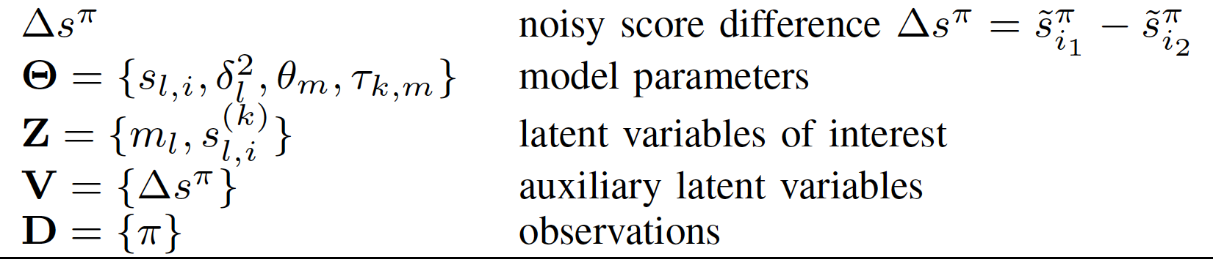
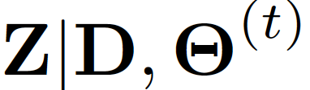
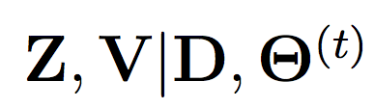
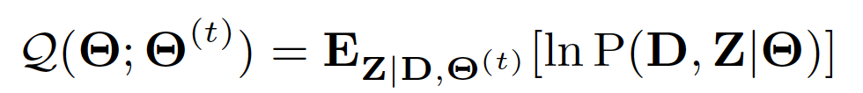
Thurstonian Pairwise Preference
EM algorithm:
intractable posterior
E-step
sampling-friendly posterior
M-step

Slide 31
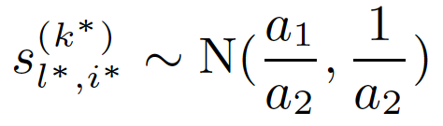
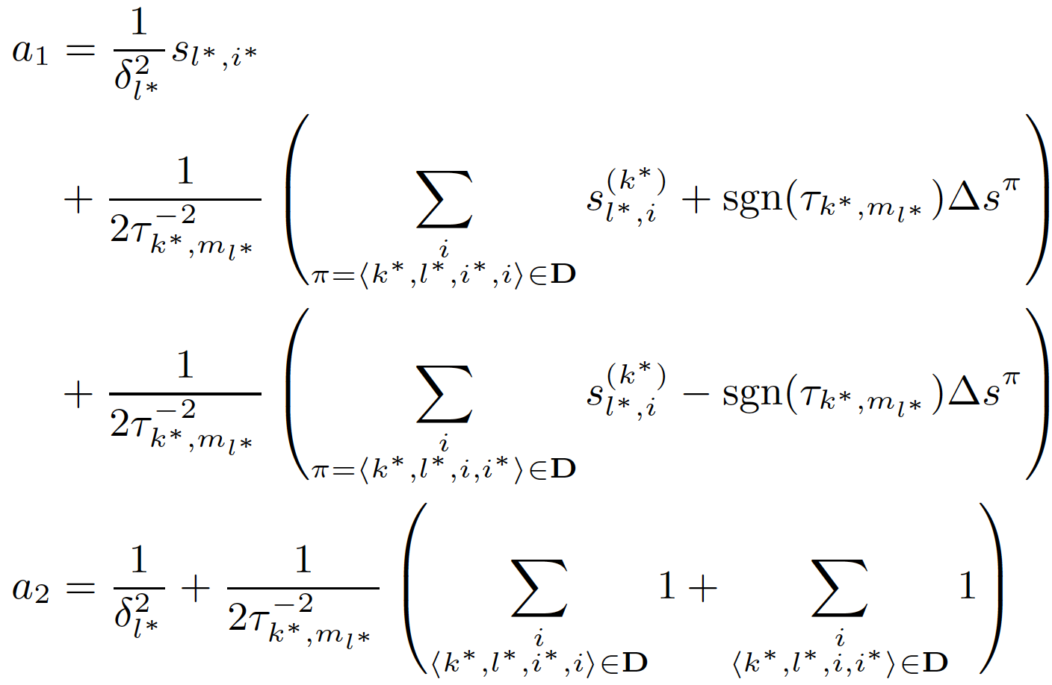
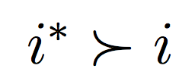
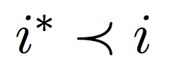
TPP: Learning by Comparison
E-step
Sample perceived score:
winning
Losing
query difficulty
domain expertise
Notes:
skip

Slide 32
TPP: Learning by Comparison
E-step
Sample perceived score:
query
difficulty
ground truth score
ground truth score
of loser +
noisy score difference
winning
domain expertise
ground truth score
of winer -
noisy score difference
Losing
Notes:
skip

Slide 33
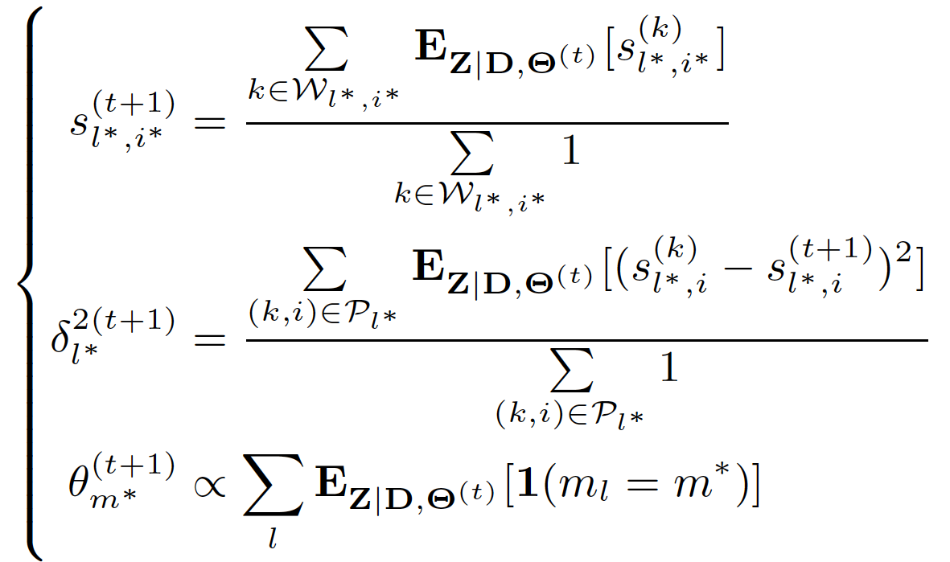
TPP: Majority Voting
M-step
empirical mean
of samples
empirical variance
of samples
empirical multinomial
of samples
Notes:
skip

Slide 34






TPP: Simulated Study
0.2
0.6
0.1
0.1
Demo 1
0.2
0.4
0.3
0.1
Demo 2
0.2
0.4
0.1
0.3
Demo 3
5 docs
30 docs
full model
same worker expertise
(Chen et al., 2013)
only 1 domain
same query difficulty

Slide 35


TPP: Domain Prediction and Efficiency

Slide 36

TPP: Malicious Worker Detection
100/200 annotators
10 malicious workers in 100 group
20 malicious workers in 200 group
Sparsity ratio
0.01 (4.35 out of 435 pairs)
0.02 (8.7 out of 435 pairs)

Slide 37

TPP: Rank Aggregation
25 retrieval systems
25 workers for TPP
Rank Aggregation Baselines:
TRM
BordaCount
Majority Voting for Ranking

Slide 38

TPP: Summary
Flexible Modelling
Modeling Pairwise Preferences in Crowdsourcing by
extending Thurstonian Ranking Model
explaining errors/uncertainty with a multitude of sources
query difficulty, query domain
worker domain expertise, worker truthfulness
EM algorithm: E-step by sampling
Powerful Tool for KDD
Efficient Optimization

Slide 39
Citation LDA: Understanding Evolution of Research Themes
Dual Clustering Maximum Entropy
PLANS: Phrasal Latent Allocation with Negative Sampling
Thurstonian Pairwise Preference

Slide 40


Maximum Entropy: A Versatile Tool
Maximum Entropy (ME) Framework:
Classification: with known feature vector
hypothesis for
positive class
t-th feature
vector
x_{t}
hypothesis for
negative class
w₁
w₂
f_{t}(neg)
f_{t}(pos)

Slide 41


Maximum Entropy: A Versatile Tool
Maximum Entropy (ME) Framework:
Embedding: with unknown feature vector (representation)
recursive ?? network
?? = neural vs ?? = social
f_{t}(neural)
Continuous Bag-of-Words (CBOW)
(Milokov et al. 2013)
v_{neural}
h_{network}
h_{recursive}
v_{social}
f_{t}(social)

Slide 42

Maximum Entropy: Difficulty in Scaling
Classes: >10⁴ MeSH (Medical Subject Heading) tags
Vocabulary: >1M words
How Does Gradient Descent (GD) of ME works?
GD Complexity:
O(DN)
D – feature dimensionality
N – number of classes
w₁
x_{t}
w₂
f_{t}(1)
w₃
3-class classification

Slide 43
Maximum Entropy: Difficulty in Scaling
Classes: > 10⁴ MeSH (Medical Subject Heading) tags
Vocabulary: >1M words
How Does Gradient Descent (GD) of ME works?
GD Complexity:
O(DN)
D – feature dimensionality
N – number of classes
w₁
x_{t}
w₂
f_{t}(2)
w₃
3-class classification

Slide 44
Maximum Entropy: Difficulty in Scaling
Classes: > 10⁴ MeSH (Medical Subject Heading) tags
Vocabulary: >1M words
How Does Gradient Descent (GD) of ME works?
GD Complexity:
O(DN)
D – feature dimensionality
N – number of classes
w₁
x_{t}
w₂
f_{t}(3)
w₃
3-class classification

Slide 45




Maximum Entropy: Difficulty in Scaling
Classes: > 10⁴ MeSH (Medical Subject Heading) tags
Vocabulary: >1M words
How Does Gradient Descent (GD) of ME works?
GD Complexity:
O(DN)
D – feature dimensionality
N – number of classes
w₁
Suppose the correct label y_{t} = 1,
and gradient descent updates:
x_{t}
w₂
w₃
3-class classification

Slide 46
Maximum Entropy: Difficulty in Scaling
Classes: > 10⁴ MeSH (Medical Subject Heading) tags
Vocabulary: >1M words
How Does Gradient Descent (GD) of ME works?
GD Complexity:
O(DN)
D – feature dimensionality
N – number of classes
w₁
Suppose the correct label y_{t} = 1,
and gradient descent updates:
x_{t}
w₂
w₃
3-class classification

Slide 47
Maximum Entropy: Difficulty in Scaling
Classes: > 10⁴ MeSH (Medical Subject Heading) tags
Vocabulary: >1M words
How Does Gradient Descent (GD) of ME works?
GD Complexity:
O(DN)
D – feature dimensionality
N – number of classes
w₁
Suppose the correct label y_{t} = 1,
and gradient descent updates:
x_{t}
w₂
w₃
3-class classification

Slide 48
Maximum Entropy: Difficulty in Scaling
Classes: > 10⁴ MeSH (Medical Subject Heading) tags
Vocabulary: >1M words
How Does Gradient Descent (GD) of ME works?
GD Complexity:
O(DN)
D – feature dimensionality
N – number of classes
w₁
Suppose the correct label y_{t} = 1,
and gradient descent updates:
x_{t}
w₂
3-class classification
w₃

Slide 49


Dual-Clustering Maximum Entropy (DCME)
w₁
w₁
x_{t}
w₁
x_{t}
w₂
w₂
w₂
GD Complexity:
O(DN)
D – feature dimensionality
N – number of classes
x_{t}
w₃
w₃
w₃
t = 1, y_{t} =1
t = 2, y_{t} =2
t = 3, y_{t} = 3
Insight:
If distributions P_{t} are same,
computation in online/offline is efficient
x₁
x₂
w₁
w₂
x₃
w₃

Slide 50
Dual-Clustering Maximum Entropy (DCME)
w₁
w₁
x_{t}
w₁
x_{t}
w₂
w₂
w₂
GD Complexity:
O(DN)
D – feature dimensionality
N – number of classes
x_{t}
w₃
w₃
w₃
t = 1, y_{t} =1
t = 2, y_{t} =2
t = 3, y_{t} = 3
Insight:
If distributions P_{t} are same,
computation in online/offline is efficient
x₁
w₁
x₂
w₂
w₃
x₃

Slide 51
Dual-Clustering Maximum Entropy (DCME)
w₁
w₁
x_{t}
w₁
x_{t}
w₂
w₂
w₂
GD Complexity:
O(DN)
D – feature dimensionality
N – number of classes
x_{t}
w₃
w₃
w₃
t = 1, y_{t} =1
t = 2, y_{t} =2
t = 3, y_{t} = 3
x₃
Insight:
If distributions P_{t} are same,
computation in online/offline is efficient
x₂
x₁

Slide 52




Dual-Clustering Maximum Entropy (DCME)
w₁
w₁
x_{t}
w₁
x_{t}
w₂
w₂
w₂
GD Complexity:
O(DN)
D – feature dimensionality
N – number of classes
x_{t}
w₃
w₃
w₃
t = 1, y_{t} =1
t = 2, y_{t} =2
t = 3, y_{t} = 3
x₃
Insight:
If distributions P_{t} are same,
computation in online/offline is efficient
x₂
x₁ + x₂ + x₃
x₁
w₁
w₂
w₃

Slide 53


Dual-Clustering Maximum Entropy (DCME)
w₁
w₁
x_{t}
w₁
x_{t}
w₂
w₂
w₂
x_{t}
Which distribution P is optimal?
w₃
w₃
w₃
t = 1, y_{t} =1
t = 2, y_{t} =2
t = 3, y_{t} = 3
Goal:
A Time Complexity
Independent of N (#class)
Solution: Approximating/Clustering Dual Distributions {P_{t}}
DCME Complexity:
O(DK)
D – feature dimensionality
K – number of clusters
if mini-batch size = O(N)
Distributions on Simplex

Slide 54



DCME: Primal-Dual ME
Conjugate between Log Partition and Negative Entropy:
Space of all distributions
Probabilities specified same as in ME
Non-negativity of KL-divergence

Slide 55



DCME: Primal-Dual ME
Conjugate between Log Partition and Negative Entropy:
Maximum Entropy
Primal-Dual ME

Slide 56



DCME: Primal-Dual ME
Primal-Dual ME
Dual-Clustering ME

Slide 57


DCME: Dual-Clustering
Using Conjugate
Again!
Updating cluster assignments (Online):
Updating cluster centers (Offline)

Slide 58

DCME: Dual-Clustering
Dual-Clustering:
K-means with Two Ingredients:
Clustering in the Simplex Space
Instead of Euclidean space
Measuring “Distance” in KL Divergence
Instead of L₂ distance

Slide 59


DCME: Dual Form as Feature Pursuit
ME:
DCME:

Slide 60

DCME: Experiment on Classification and Embedding
Baselines:
Gradient Descent
Noise-Contrastive Estimation
Negative Sampling
(Mikolov et al. 2013 )

Slide 61
DCME: Summary
Flexible Modelling
Modeling Dual Distributions in Maximum Entropy:
K-means latent clustering
Approximating each distribution by the corresponding cluster center
Scalable Optimization:
A hybrid online-offline algorithm
Complexity depends only on #cluster, but not #class
Effective model update: no sampling involved
Efficient Optimization

Slide 62
Citation LDA: Understanding Evolution of Research Themes
Dual Clustering Maximum Entropy
PLANS: Phrasal Latent Allocation with Negative Sampling
Thurstonian Pairwise Preference

Slide 63

Embedding: Beyond Word Representation
Word Embedding: A Skipgram Scheme
W_{t-2}
W_{t-1}
W_{t}
W_{t+1}
W_{t+2}
Maximize: log P(w_{t}|w_{t-2})

Slide 64

Embedding: Beyond Word Representation
Word Embedding: A Skipgram Scheme
W_{t-2}
W_{t-1}
W_{t}
W_{t+1}
W_{t+2}
Maximize: log P(w_{t}|w_{t-2}) + log P(w_{t}|w_{t-1})

Slide 65

Embedding: Beyond Word Representation
Word Embedding: A Skipgram Scheme
W_{t-2}
W_{t-1}
W_{t}
W_{t+1}
W_{t+2}
Maximize: log P(w_{t}|w_{t-2}) + log P(w_{t}|w_{t-1}) + log P(w_{t}|w_{t+1})

Slide 66

Embedding: Beyond Word Representation
Word Embedding: A Skipgram Scheme
W_{t-2}
W_{t-1}
W_{t}
W_{t+1}
W_{t+2}
Maximize: log P(w_{t}|w_{t-2}) + log P(w_{t}|w_{t-1}) + log P(w_{t}|w_{t+1}) + log P(w_{t}|w_{t+2})
Limitations of Bag-of-Words Assumption:
Words are contextually unaware
bank
“I made a deposit in the bank.”
“We walked on the river bank.”

Slide 67
Embedding: Beyond Word Representation
Word Embedding: A Skipgram Scheme
W_{t-2}
W_{t-1}
W_{t}
W_{t+1}
W_{t+2}
Maximize: log P(w_{t}|w_{t-2}) + log P(w_{t}|w_{t-1}) + log P(w_{t}|w_{t+1}) + log P(w_{t}|w_{t+2})
Limitations of Bag-of-Words Assumption:
Words are contextually unaware
Sentence is simple average of words
presidential residence
the White House
the house in white
Machine
Human

Slide 68
PLANS: Phrasal Latent Allocation with Negative Sampling
Jointly Learning of:
Phrasal Allocation
computer
scientists
working
in
artificial
intelligence
and
machine
learning
artificial

Slide 69
PLANS: Phrasal Latent Allocation with Negative Sampling
Jointly Learning of:
Phrasal Allocation
computer
scientists
working
in
artificial
intelligence
and
machine
learning
in artificial

Slide 70
PLANS: Phrasal Latent Allocation with Negative Sampling
Jointly Learning of:
Phrasal Allocation
computer
scientists
working
in
artificial
intelligence
and
machine
learning
working in artificial

Slide 71
PLANS: Phrasal Latent Allocation with Negative Sampling
Jointly Learning of:
Phrasal Allocation
computer
scientists
working
in
artificial
intelligence
and
machine
learning
in artificial intelligence

Slide 72
PLANS: Phrasal Latent Allocation with Negative Sampling
Jointly Learning of:
Phrasal Allocation
computer
scientists
working
in
artificial
intelligence
and
machine
learning
artificial intelligence and

Slide 73
PLANS: Phrasal Latent Allocation with Negative Sampling
Jointly Learning of:
Phrasal Allocation
computer
scientists
working
in
artificial
intelligence
and
machine
learning
artificial intelligence

Slide 74
PLANS: Phrasal Latent Allocation with Negative Sampling
Jointly Learning of:
Phrasal Allocation
Embedding Estimation
computer
scientists
working
in
artificial
intelligence
and
machine
learning
artificial intelligence
artificial intelligence
algorithm
machine learning
artificial food additives
Embedding space

Slide 75



PLANS: Phrasal Latent Allocation with Negative Sampling
Jointly Learning of:
Phrasal Allocation
Embedding Estimation
computer
scientists
working
in
artificial
intelligence
and
machine
learning
artificial intelligence
artificial intelligence
algorithm
machine learning
artificial food additives
Embedding space

Slide 76

PLANS: Phrasal Latent Allocation with Negative Sampling
Jointly Learning of:
Phrasal Allocation
Embedding Estimation
computer
scientists
working
in
artificial
intelligence
and
machine
learning
artificial intelligence
artificial intelligence
algorithm
machine learning
artificial food additives
Embedding space

Slide 77


PLANS: Ingredient 1 Transient Chinese Restaurant Process
Chinese Restaurant Process
Dirichlet Process (DP) generalizes multinomial distribution
Infinite dimension
CRP is an implementation of sampling from DP
Gibbs sampling with replacement
3
2
3

Slide 78

PLANS: Ingredient 1 Transient Chinese Restaurant Process
Chinese Restaurant Process
Dirichlet Process (DP) generalizes multinomial distribution
Infinite dimension
CRP is an implementation of sampling from DP
Gibbs sampling with replacement
…
2
2
3
$$α$$

Slide 79
PLANS: Ingredient 1 Transient Chinese Restaurant Process
Chinese Restaurant Process
Dirichlet Process (DP) generalizes multinomial distribution
Infinite dimension
CRP is an implementation of sampling from DP
Gibbs sampling with replacement
…
2
3
3
$$α$$

Slide 80
PLANS: Ingredient 1 Transient Chinese Restaurant Process
Chinese Restaurant Process
Dirichlet Process (DP) generalizes multinomial distribution
Infinite dimension
CRP is an implementation of sampling from DP
Gibbs sampling with replacement
…
1
3
3
$$α$$

Slide 81
PLANS: Ingredient 1 Transient Chinese Restaurant Process
Chinese Restaurant Process
Dirichlet Process (DP) generalizes multinomial distribution
Infinite dimension
CRP is an implementation of sampling from DP
Gibbs sampling with replacement
…
1
3
3
1
$$α$$

Slide 82
PLANS: Ingredient 1 Transient Chinese Restaurant Process
Chinese Restaurant Process
Dirichlet Process (DP) generalizes multinomial distribution
Infinite dimension
CRP is an implementation of sampling from DP
Gibbs sampling with replacement
…
1
3
2
1
$$α$$

Slide 83
PLANS: Ingredient 1 Transient Chinese Restaurant Process
Chinese Restaurant Process
Dirichlet Process (DP) generalizes multinomial distribution
Infinite dimension
CRP is an implementation of sampling from DP
Gibbs sampling with replacement
…
2
3
2
1
$$α$$
Limitations of CRP:
Cannot sample without replacement (customers in a stream)
Each customer chooses from all tables in the restaurants

Slide 84

PLANS: Ingredient 1 Transient Chinese Restaurant Process
Customers arrives in a stream
Seating choice is limited to possible phrases only
Transient Chinese Restaurant Process
…
…
$$α$$
intelligence $α$/3
artificial intelligence $α$/3
intelligence algorithms $α$/3
artificial intelligence algorithms

Slide 85
PLANS: Ingredient 1 Transient Chinese Restaurant Process
Customers arrives in a stream
Seating choice is limited to possible phrases only
Transient Chinese Restaurant Process
…
…
intelligence
$$α$$
intelligence $α$/3
artificial intelligence $α$/3
intelligence algorithms $α$/3
artificial intelligence algorithms

Slide 86

PLANS: Ingredient 1 Transient Chinese Restaurant Process
Customers arrives in a stream
Seating choice is limited to possible phrases only
Transient Chinese Restaurant Process
…
intelligence
1
$$α$$
intelligence 1
machine intelligence $α$/2
intelligence algorithms $α$/2
machine intelligence algorithms

Slide 87
PLANS: Ingredient 1 Transient Chinese Restaurant Process
Customers arrives in a stream
Seating choice is limited to possible phrases only
Transient Chinese Restaurant Process
…
intelligence
2
$$α$$
intelligence 1
machine intelligence $α$/2
intelligence algorithms $α$/2
machine intelligence algorithms

Slide 88

PLANS: Ingredient 1 Transient Chinese Restaurant Process
Customers arrives in a stream
Seating choice is limited to possible phrases only
Transient Chinese Restaurant Process
…
intelligence
2
$$α$$
intelligence 2
artificial intelligence $α$/2
intelligence technique $α$/2
artificial intelligence technique

Slide 89
PLANS: Ingredient 1 Transient Chinese Restaurant Process
Customers arrives in a stream
Seating choice is limited to possible phrases only
Transient Chinese Restaurant Process
…
intelligence
AI
2
1
$$α$$
intelligence 2
artificial intelligence $α$/2
intelligence technique $α$/2
artificial intelligence technique

Slide 90

PLANS: Ingredient 1 Transient Chinese Restaurant Process
Customers arrives in a stream
Seating choice is limited to possible phrases only
Transient Chinese Restaurant Process
…
intelligence
AI
2
1
$$α$$
artifical $α\text{/2}$
artificial intelligence 1
in artificial $α$/2
in artifical intelligence

Slide 91
PLANS: Ingredient 1 Transient Chinese Restaurant Process
Customers arrives in a stream
Seating choice is limited to possible phrases only
Transient Chinese Restaurant Process
…
intelligence
AI
2
2
$$α$$
artifical $α\text{/2}$
artificial intelligence 1
in artificial $α$/2
in artifical intelligence

Slide 92

PLANS: Ingredient 1 Transient Chinese Restaurant Process
Customers arrives in a stream
Seating choice is limited to possible phrases only
Transient Chinese Restaurant Process
…
intelligence
AI
2
2
$$α$$
theory $α\text{/}$3
learning theory $α\text{/}$3
theory paper $α$/3
learning theory paper

Slide 93
PLANS: Ingredient 1 Transient Chinese Restaurant Process
Customers arrives in a stream
Seating choice is limited to possible phrases only
Transient Chinese Restaurant Process
…
intelligence
AI
learning theory
2
2
1
$$α$$
theory $α\text{/}$3
learning theory $α\text{/}$3
theory paper $α$/3
learning theory paper

Slide 94

PLANS: Ingredient 1 Transient Chinese Restaurant Process
Customers arrives in a stream
Seating choice is limited to possible phrases only
Transient Chinese Restaurant Process
…
Periodical Shrinking Mechanism:
Admits I customers each “day”
Customers leave with $P=β$
Sort & Prune top V tables
intelligence
AI
learning theory
ML
6
4
2
4
$$α$$

Slide 95


PLANS: Ingredient 1 Transient Chinese Restaurant Process
Customers arrives in a stream
Seating choice is limited to possible phrases only
Transient Chinese Restaurant Process
…
Periodical Shrinking Mechanism:
Admits I customers each “day”
Customers leave with $P=β$
Sort & Prune top V tables
intelligence
AI
learning theory
ML
Customers Leave
6
4
2
4
$$α$$
3
2
1
2
$β$=0.5
(exponential aging)

Slide 96
PLANS: Ingredient 1 Transient Chinese Restaurant Process
Customers arrives in a stream
Seating choice is limited to possible phrases only
Transient Chinese Restaurant Process
…
Periodical Shrinking Mechanism:
Admits I customers each “day”
Customers leave with $P=β$
Sort & Prune top V tables
intelligence
AI
learning theory
ML
Customers Leave
6
4
2
4
$$α$$
3
2
1
2
$β$=0.5

Slide 97

PLANS: Ingredient 1 Transient Chinese Restaurant Process
Customers arrives in a stream
Seating choice is limited to possible phrases only
Transient Chinese Restaurant Process
…
Periodical Shrinking Mechanism:
Admits I customers each “day”
Customers leave with $P=β$
Sort & Prune top V tables
intelligence
AI
learning theory
ML
Remove Tables
$$α$$
Prune
V=3

Slide 98
PLANS: Ingredient 1 Transient Chinese Restaurant Process
Customers arrives in a stream
Seating choice is limited to possible phrases only
Transient Chinese Restaurant Process
…
Periodical Shrinking Mechanism:
Admits I customers each “day”
Customers leave with $P=β$
Sort & Prune top V tables
intelligence
AI
ML
tCRP:
Encourages richer get richer
Maintains a affordable size of phrases by sort & prune
Models an infinite-dimensional multinomial in stream data
$$α$$

Slide 99

PLANS: Ingredient 2 Negative Sampling
Negative Sampling for PLANS:
W_{t-3}
W_{t-2}
W_{t-1}
W_{t}
W_{t+1}
W_{t+2}

Slide 100

PLANS: Ingredient 2 Negative Sampling
Negative Sampling for PLANS:
W_{t-3}
W_{t-2}
W_{t-1}
W_{t}
W_{t+1}
W_{t+2}

Slide 101

PLANS: Ingredient 2 Negative Sampling
Negative Sampling for PLANS:
W_{t-3}
W_{t-2}
W_{t-1}
W_{t}
W_{t+1}
W_{t+2}

Slide 102

PLANS: Ingredient 2 Negative Sampling
Negative Sampling for PLANS:
W_{t-3}
W_{t-2}
W_{t-1}
W_{t}
W_{t+1}
W_{t+2}

Slide 103

PLANS: Ingredient 2 Negative Sampling
Negative Sampling for PLANS:
W_{t-3}
W_{t-2}
W_{t-1}
W_{t}
W_{t+1}
W_{t+2}

Slide 104


PLANS: Ingredient 2 Negative Sampling
Negative Sampling for PLANS:
W_{t-3}
W_{t-2}
W_{t-1}
W_{t}
W_{t+1}
W_{t+2}
Negative Sampling
from
Noisy Distribution

Slide 105
PLANS: Ingredient 2 Negative Sampling
Negative Sampling for PLANS:
W_{t-3}
W_{t-2}
W_{t-1}
W_{t}
W_{t+1}
W_{t+2}
Phrasal Allocation
tCRP
Negative Sampling
Optimization: Posterior-Sampling EM

Slide 106



PLANS: Ingredient 3 Simulated Annealing
Simulated Annealing (SA) for PLANS:
Decreases the stochastic behavior of sampling towards the end of training
Stabilizes the phrase set, but continues optimizing the embeddings
Example: “solve the phrasal allocation problem with PLANS ”
Phrasal Allocation without SA
SA with temperature T
Geometric Cooling Schedule
temp
T=1
T=0.5
T=0.2
T=0.1
Cooling
iter

Slide 107


PLANS: Evaluation
Phrasal Allocation:
Data: NY Times
Baseline: PMI
Result:

Slide 108

PLANS
Phrasal Allocation Evaluation
Variable-length phrases
Non-decomposable phrases

Slide 109

PLANS
Phrase Semantic Evaluation
Nearest neighbor by cosine similarity

Slide 110

PLANS: Evaluation
Actors, actress
(co-starred, action-movies)
Musicians, bands (rock)

Slide 111

PLANS: Evaluation
Politicians (Asian),
Masao Iwasato is Lee Teng-Hui’s Japanese name
Stock exchange (Asian)

Slide 112

PLANS: Evaluation
Locations known for
its technology companies
Universities in Midwest or known for its enginneering

Slide 113

PLANS
Sensitivity analysis

Slide 114

PLANS: Summary
Flexible Modelling
Powerful Tool for KDD
Modeling Phrasal Allocation and Embedding:
Transient Chinese Restaurant Process
Nonparametric partial-generative model
Dynamical aging, sorting and pruning the phrases
Efficient Optimization -- EM with Posterior Sampling:
Negative Sampling
Efficient embedding estimation
Simulated Annealing
Reducing stochastic behavior of sampling
Efficient Optimization

Slide 115
PLVM: Conclusion
PLVM Models Knowledge as Latent Variables
Knowledge discover amounts to Maximum Likelihood Estimation or Bayesian Inference
PLVM is a powerful and flexible tool
PLVM is a generative process to explain the observations as distributions parametrized by the latent variables
Each generative step in PLVM is simple and flexible
PLVM Models data of different types: continuous, discrete, distribution, uncertainty, etc.
PLVM Can be Leveraged for Optimization by Model Reduction or Sampling
Improves efficiency of existing algorithms such as Maximum Entropy
For complicated posterior, trades tractability with accuracy by sampling

Slide 116
Thank You!
Questions?

